Slide 1
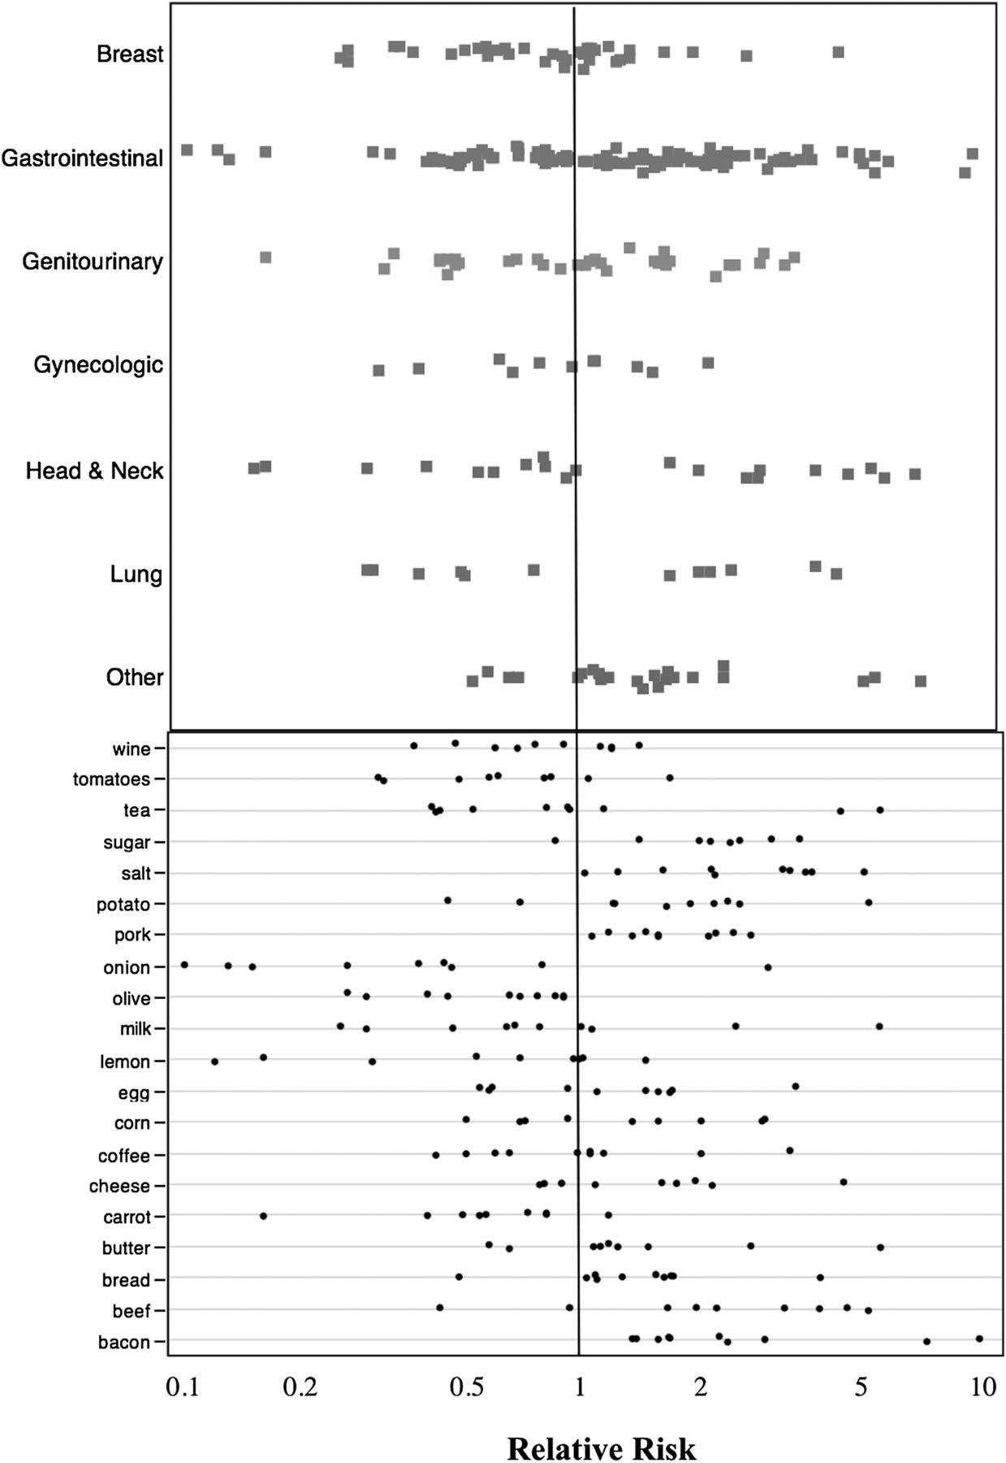
Effect estimates reported in the literature by malignancy type (top) or ingredient (bottom).
Jonathan D Schoenfeld, and John PA Ioannidis Am J Clin Nutr 2012;97:127-134
©2013 by American Society for Nutrition
Notes:
Effect estimates reported in the literature by malignancy type (top) or ingredient (bottom). Only ingredients with ≥10 studies are shown. Three outliers are not shown (effect estimates >10).

